Slide 1

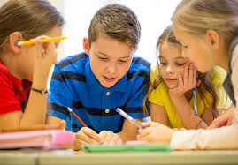

Team building in the Classroom
Team building in the Classroom
HeadsTogether!

Slide 2
Team building in the Classroom
Why team build?
students better understand each other's strengths, weaknesses and interests
develops a support group that assists resilience and communication
helps them work together better in the future
HeadsTogether!

Slide 3

Team building in the Classroom
What does that classroom look like?
HeadsTogether!

Slide 4
Team building in the Classroom
When we work as a team, we become more able.
Why?
What do we gain from this?
HeadsTogether!

Slide 5
Adept:
Become proficient
Brave:
The capacity to try
ABLE
Liberty:
Without restriction
Expert:
The chance to shine
HeadsTogether!

Slide 6
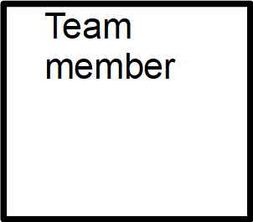


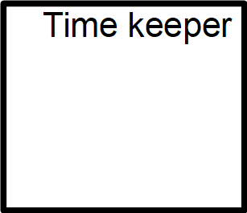
HeadsTogether!

Slide 7
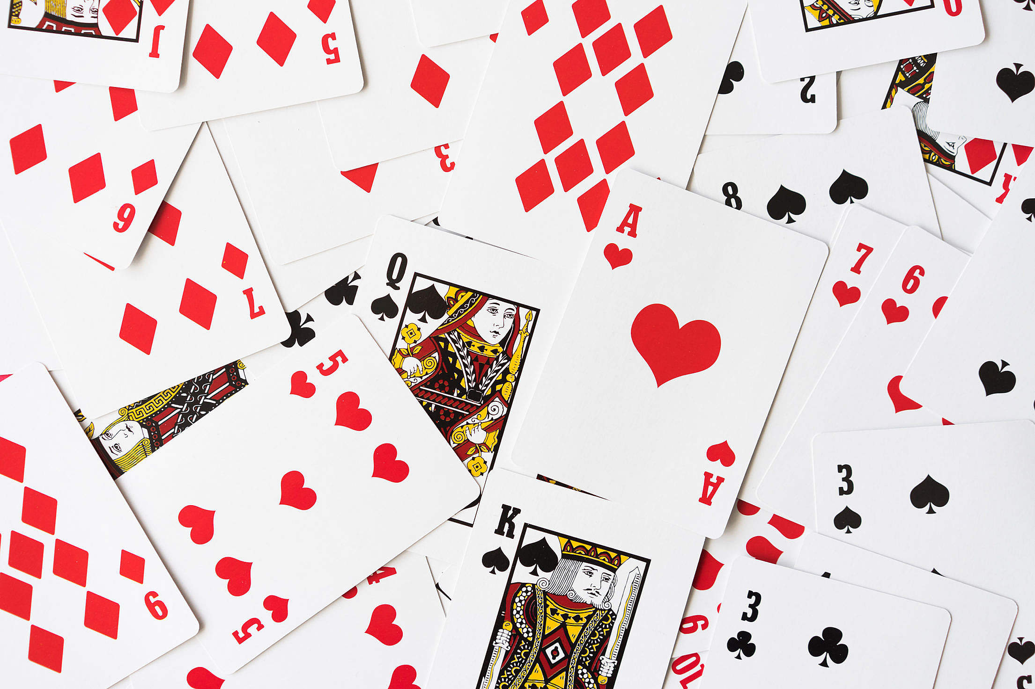
Team building in the Classroom
HeadsTogether!

Slide 8
Team building in the Classroom
Ability needs practice....
with practice we are more able
when we are more able
we are more motivated
HeadsTogether!

Slide 9
Team building in the Classroom
HeadsTogether!

Slide 10
Team building in the Classroom
When we encourage team building, it breaks down pre conceptions students have of each others ability.
They get to see students in a different “light”
They learn consideration, tolerance, reflection, patience, resilience.......
HeadsTogether!

Slide 11
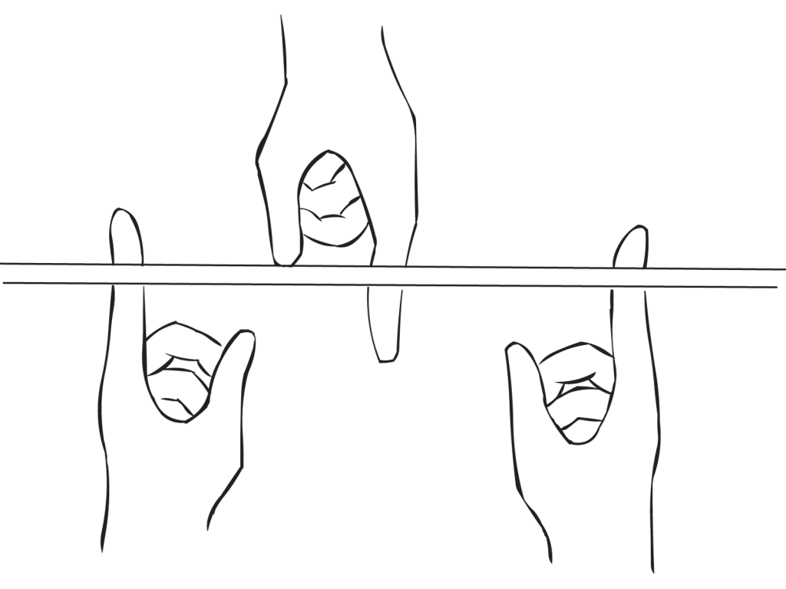
Team building in the Classroom
2 watchers
8
players
Stand in groups of 4 facing each other
Place your arms in front and put out your index finger on each hand (as above)
Watcher stand each end – at all times only fingers to touch the stick
Lower the stick to the ground
HeadsTogether!

Slide 12
Team building in the Classroom
What was the initial reaction of the group?
How well did the group cope with this challenge?
What skills did it take to be successful as a group?
What creative solutions were suggested and how were they received?
What would an outside observer have seen as the strengths and weaknesses of the group?
What roles did people play?
What did each group member learn about him/herself as an individual?
HeadsTogether!

Slide 13
Team building in the Classroom
Sample websites
https://www.jubed.com/search/team-building-teamwork
https://www.persil.com/uk/dirt-is-good/games/5-great-team-games-kids.html
https://www.nyy.org.uk/sites/default/files/youth_resource/Team%20Building%20Games.pdf
https://www.teachthought.com/critical-thinking/10-team-building-games-that-promote-critical-thinking/
https://www.tes.com/teaching-resources/blog/team-building-tasks-secondary
HeadsTogether!

